Slide 1
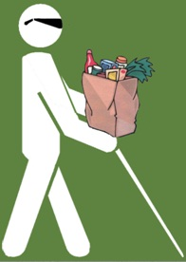
Grocery Shopping Assistant for the Visually Impaired (GroZi)
Ave Joo Byoung Park
(TIES Intern Summer 2010)

Slide 2
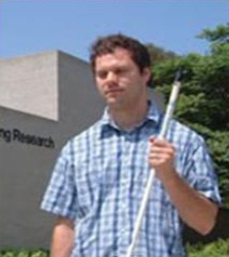
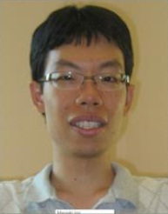
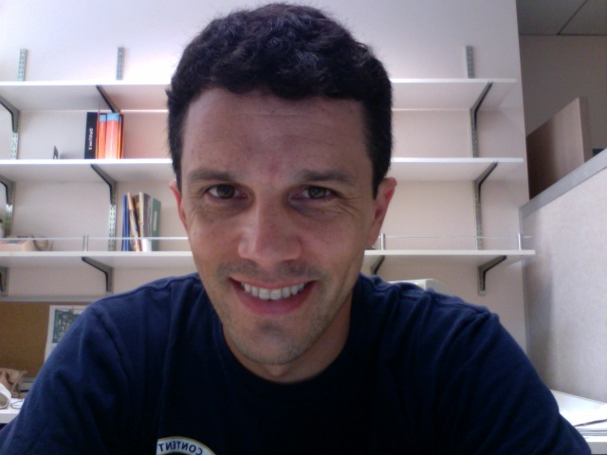
Team Members
Supervisor:
Prof. Serge Belongie
Client:
Dr. John Miller
Visiting Scholar:
Masaaki Kokawa

Slide 3
Mission Statement
The GroZi project is working to develop a portable handheld device that can “see”, helping the visually impaired navigate more efficiently within difficult environments as well as better locate objects and locations of interest.

Slide 4
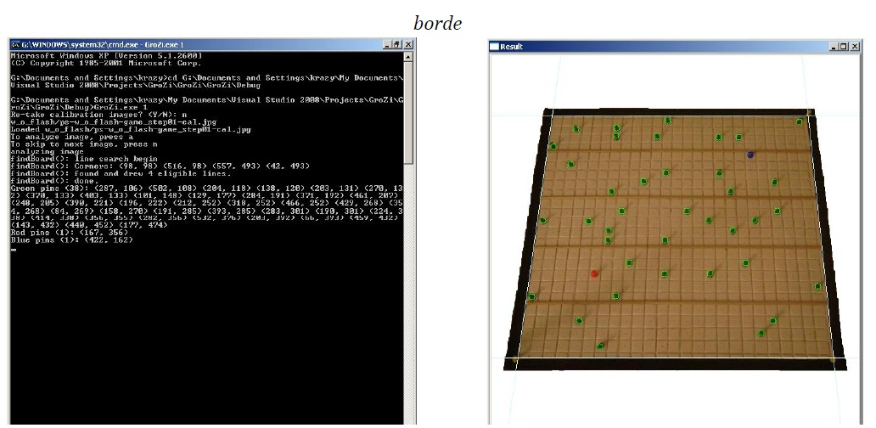
Introduction
Ultimate Goal: coming up with a device that can help the blind do the grocery shopping
Ongoing project since 2007
Consist of three sub-teams
Computer Vision Sighted Guide
Wiimote
Hardware Design

Slide 5
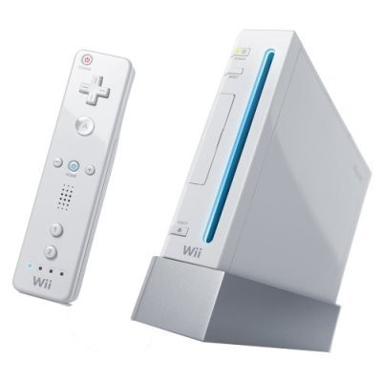
Goals for this Summer
Studying and proving the concept of finger motion tracking
Running the finger motion tracking simulation by using a Wiimote

Slide 6
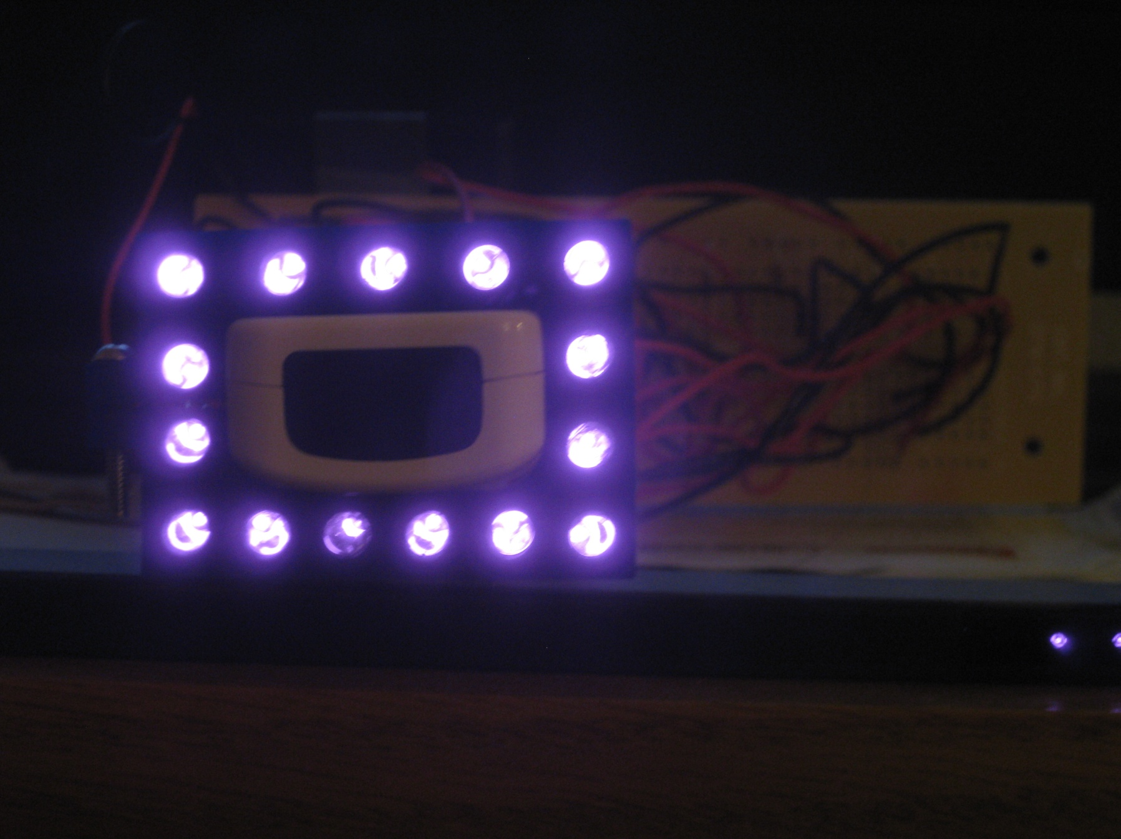
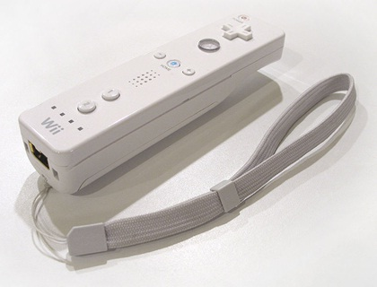
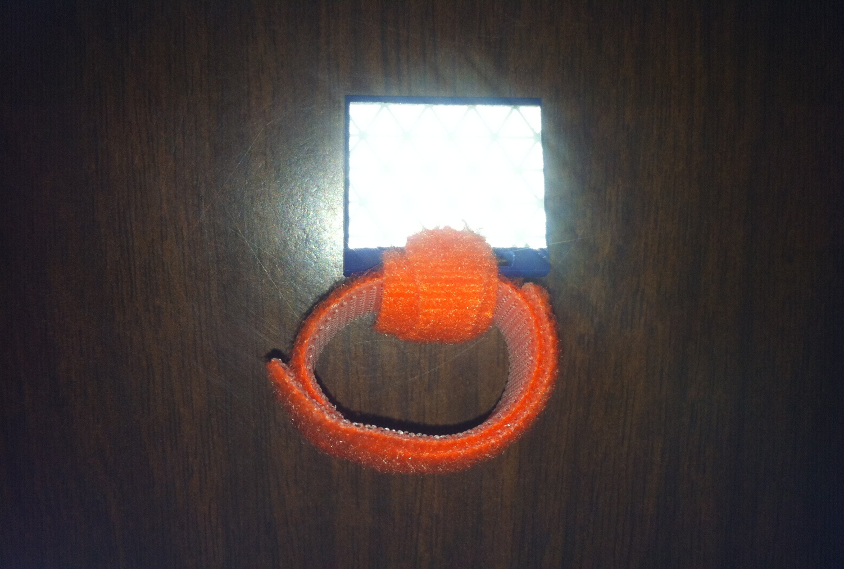
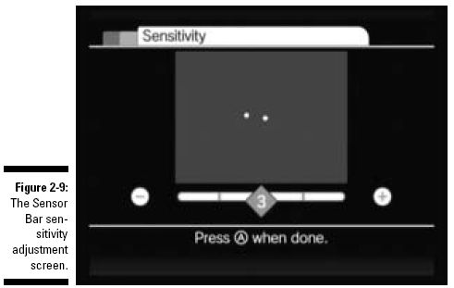
Details of the Simulation
Finger mounted reflective device (e.g. ring)
Wiimote as an IR signal receiver
IR LED array as a light source
Use Wii sensitivity mode

Slide 7
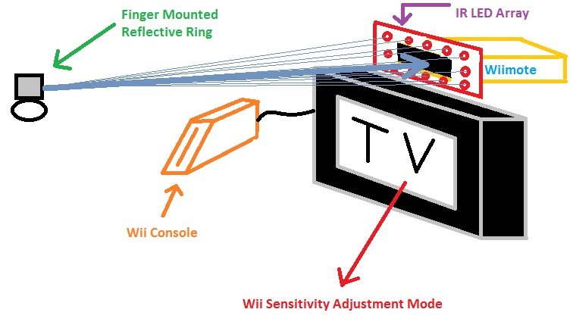
General Diagram of the Simulation

Slide 8
Finger Mounted Reflective Ring
Constructed reflective ring prototypes
Materials used:
Acrylic
Velcro
Reflective tape
The prototype design is functional but may be modified in the future

Slide 9
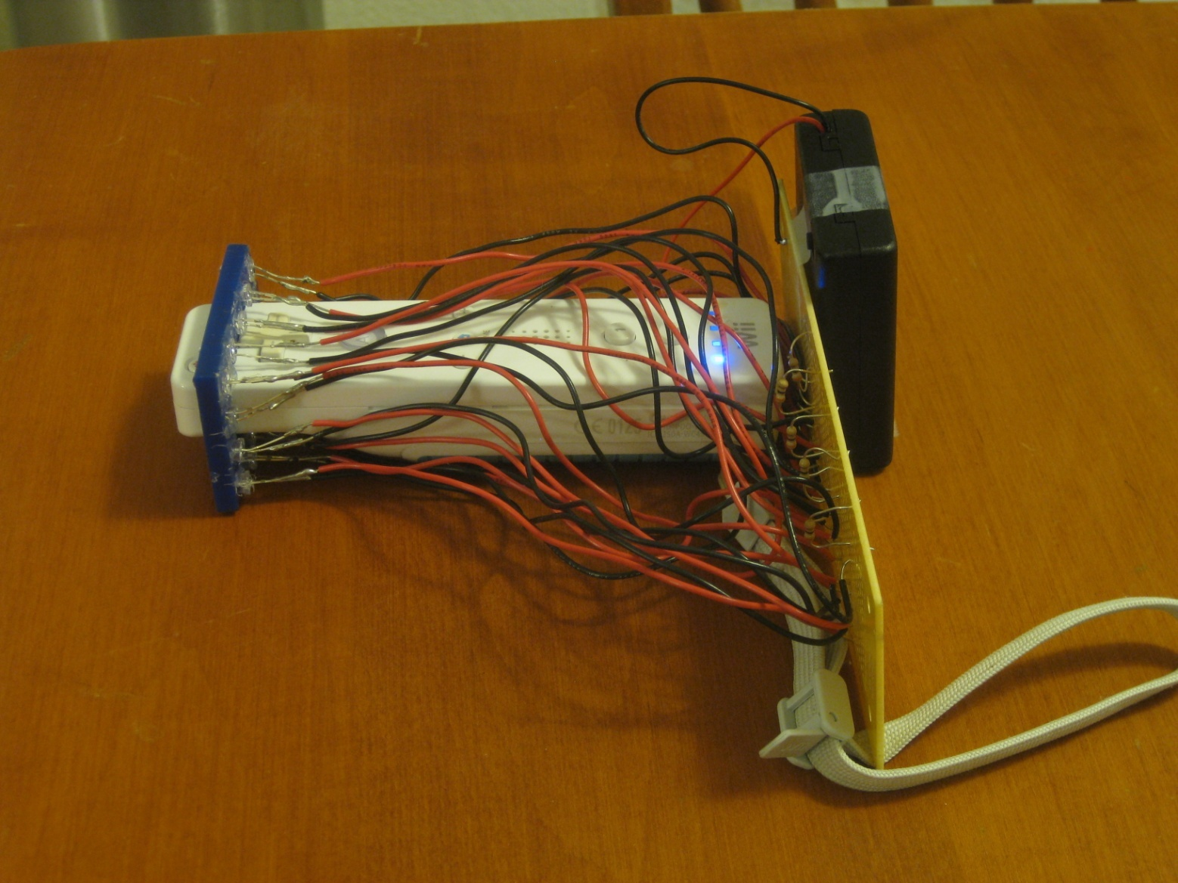
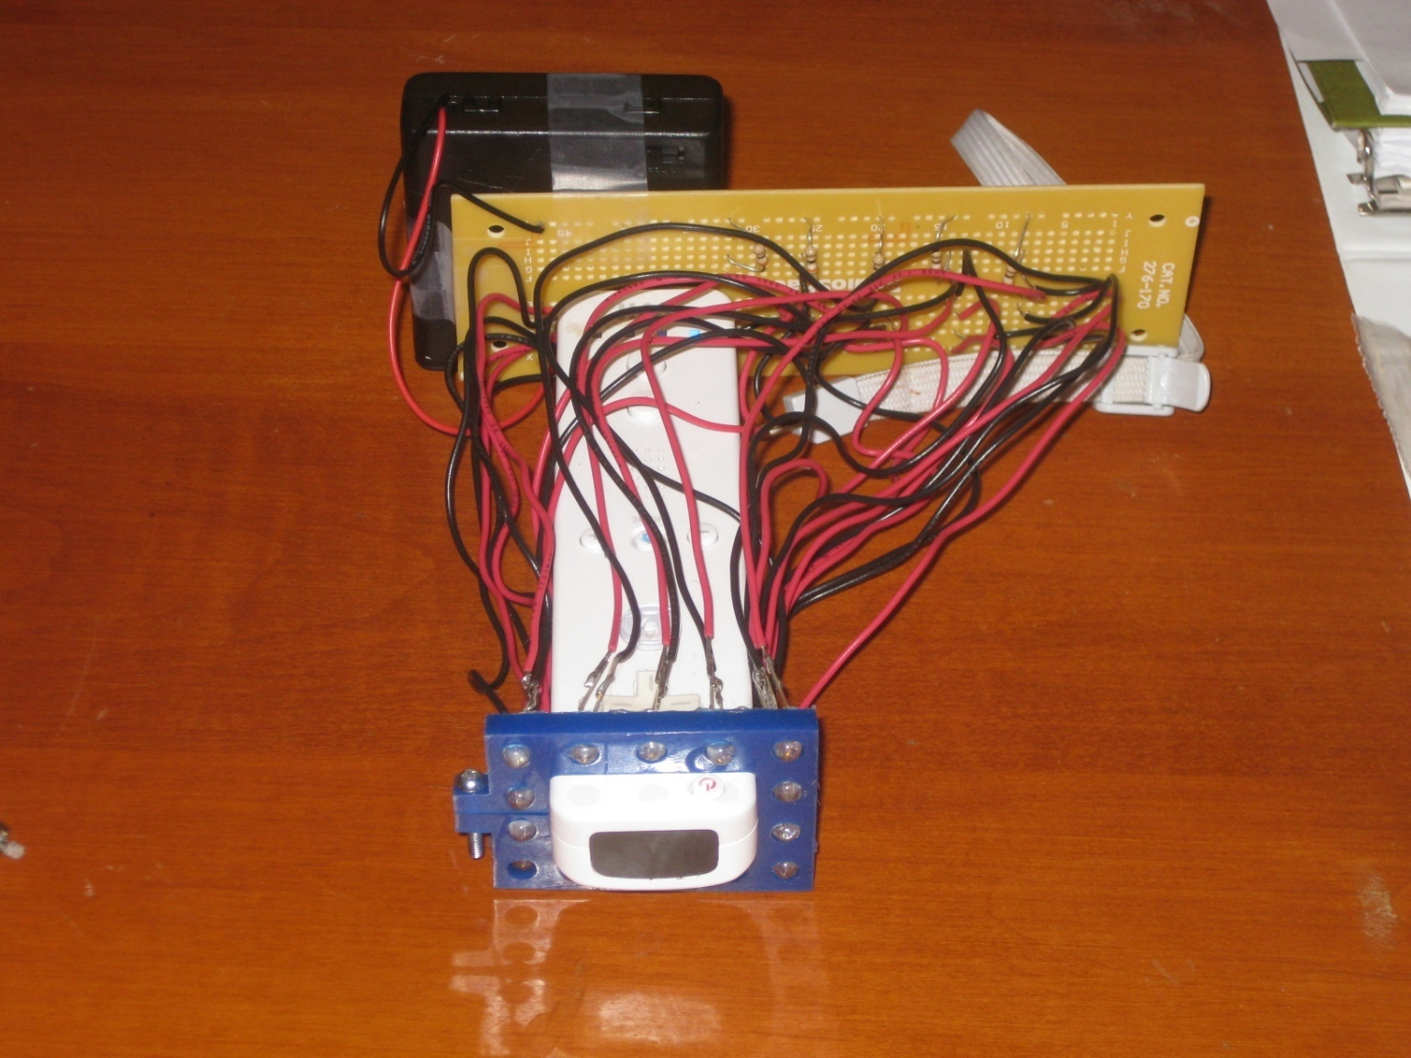
IR LED Array

Slide 10
Sensitivity Adjustment Test
Testing with the reflective ring
Testing with hand mirror

Slide 11
Comments on the Test
The concept is proven and minor adjustments planned for the future
IR LED emission not strong enough
The LED emitting angle not wide enough (e.g. 30 degree)
Mirror instead of reflective ring?
Reflects well → but not suitable
Reflects the light only at the angle it came in
Easy to lose the incoming light because of its characteristic

Slide 12
Conclusion
Use more IR LEDs (approx. 25 to 50 IR LEDs)
Purchase IR LEDs that have wide range of emission (50-60 degree)
Design a curved IR LED array
Start implementing the system in a compact manner

Slide 13
Reference
Johnny Chung Lee’s Wii Projects
http://johnnylee.net/projects/wii/
Finger Tracking Wikipedia
http://en.wikipedia.org/wiki/Finger_tracking

Slide 14
Acknowledgements
Give thanks to:
Ph D. Serge Belongie
Ph D. John Miller
Chris Cassidy and MAE 3 Design Studio
Rigo Marin and ECE Laboratory Shop
Ph D. Mandy Bratton
Barb Donovan
Zach Salin
Fellow TIES Interns

Slide 15
Q&A
Any Questions?

